Slide 1
Understanding Operational Risk: Analysis on LEL & H₂S Exposure Incidents
By: Thomas Nguyen
(EH&S Data & Analytics Intern)

Slide 2
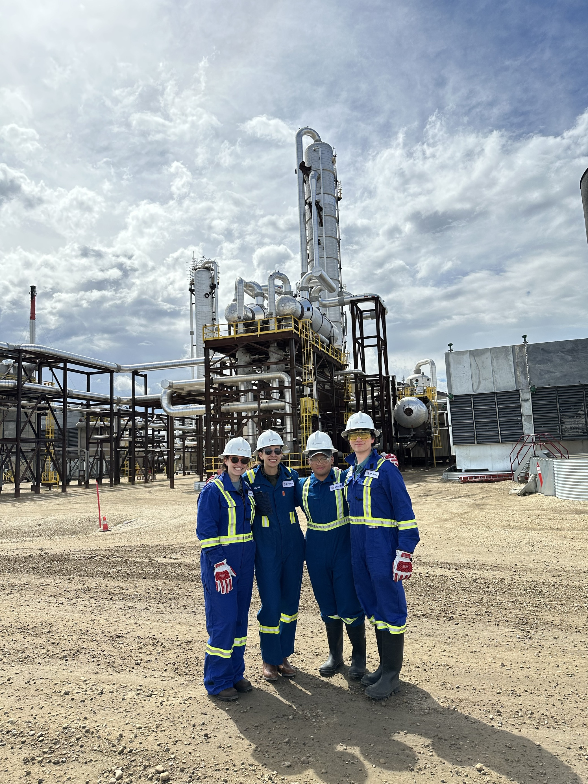

Self-Introduction
ABOUT ME
Background
BSBA in Information Systems from CU Denver
Position
EH&S Data and Analytics Intern
Plans after college
Enter the workforce
MS in Analytics from GA Tech
Favorite Activities:
Traveling, backpacking in the outdoors, hiking, trying new dishes, weightlifting, biking, spending time with friends and family
Notes:
Through this position, I've gotten a lot of exposure to the oil and gas industry and I'm very grateful for that.

Slide 3
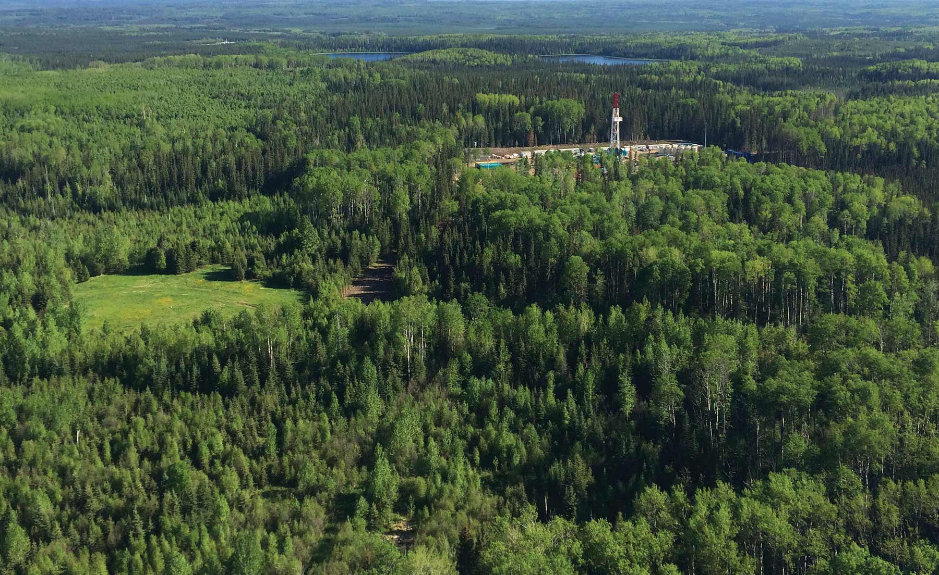
Presentation Overview
OVERVIEW
Project Background
Profiling Tasks
Hot-Spot Analysis
Solutions, Impact, & Next Steps

Slide 4
Project Background
Project Scope, Blackline Safety Monitors, & Data Collection Process

Slide 5

Blackline Project Overview
PROJECT BACKGROUND
Big Picture
A collaborative effort
Explore solutions for reducing risks and improve working conditions
Core Values
Safety: Improve health of the field operators through risk mitigation
Sustainability: Commitment in sustaining safe work environments
Integrity: Ensuring the data that collected is transparent and reliable
Team Specific Goals
Assess if certain tasks have higher exposure levels
Pinpoint sites with elevated exposure levels
Sources: OSHA, CDC, and Safety-Line Lone Worker
Notes:
Introduction
Project Background: The Blackline Project is a collaborative effort involving multiple teams and the primary objective is to explore options for reducing risks and enhancing working conditions for our field operators. Within my team, we aimed to explore and determine if certain tasks for daily operations, such as pigging, purging, and maintenance, are more prone to heightened exposure levels of H2S and/or LEL. We also wanted to identify if specific sites consistently show elevated exposure risks compared to others. My role involved gathering relevant data and conducting thorough analysis to provide our team with insights for making data-driven, actionable recommendations, aimed at enhancing safety protocols, and mitigating risks associated with these hazardous gasses.
How the Project Directly Touches the Core Values
Safety: By identifying tasks and sites with higher exposure risks, the project directly addresses potential health hazards for field operators, ensuring their safety and well-being.
Sustainability: Implementing improved safety measures helps in sustaining a safe working environment over the long term, ensuring that current practices do not compromise future safety standards.
Integrity: The data collection process and analysis process adheres to ethical and honest practices, ensuring that all findings are obtained from accurate and reliable data.

Slide 6
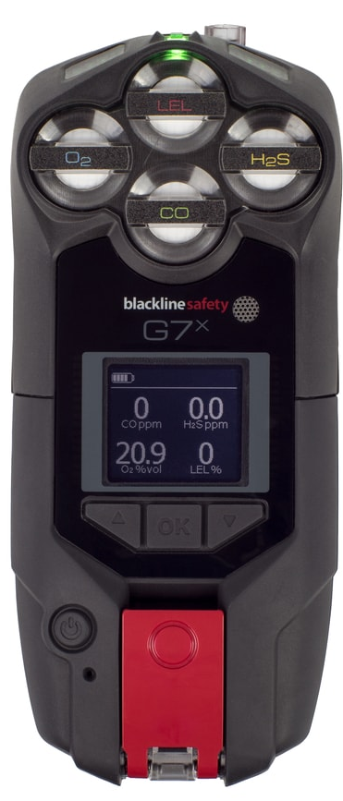


Blackline Safety Monitors
PROJECT BACKGROUND
Blackline Safety™ G7x
Detects H₂S, gasses at their LEL, O₂, and CO
Focus is on H₂S and LEL
LEL
H₂S (Hydrogen Sulfide)
Range: 0 ppm to 100 ppm
Alarm goes off at 10 ppm
LEL (Lower Explosive Limits)
Range: 0% to 100%
Alarm goes off at 10%
H₂S
Sources: OSHA, CDC, and Safety-Line Lone Worker
Notes:
Blackline: Series 7 is a satellite-connected safety monitoring device. Key capabilities and functionalities include:
Gas Detection: The G7 Series can detect multiple gasses, including H2S, flammable gasses under LEL, O2, and CO, providing real-time alerts for dangerous gas levels – however, the primary focus is LEL and H2S
For LEL %: The Blackline safety monitor typically goes off when the LEL (Lower Explosive Limit) reaches 10%. This threshold is standard for many gas detectors to ensure early warning.
For Hydrogen Sulfide (H2S): The Blackline G7x series safety monitor goes off
Low Alarm: 10 parts per million (ppm)

Slide 7
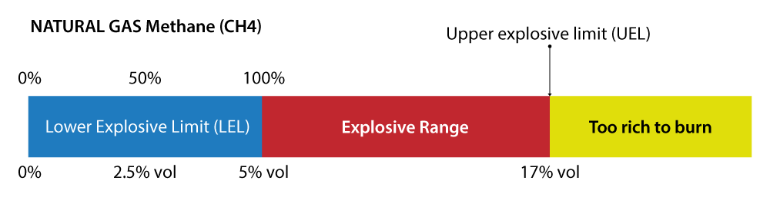
LEL & H₂S
PROJECT BACKGROUND
Lower Explosive Limit (LEL)
Lowest concentration of a gas in the air that cause an explosion (if ignition source is nearby)
An example: Methane
LEL for Methane is 5% by vol or 100% LEL
60% - 99% (3% - 4.95% Methane): Considered dangerous and highly flammable
Hydrogen Sulfide H₂S
Smells like rotten eggs at lower concentration but becomes undetectable at higher concentration (DEADLY!)
Health effects (H₂S Poisoning):
10-99 ppm: Eye + respiratory irritation
≥100 (Over-limit!): Immediate danger to health and life
500-700 ppm: Blackout + respiratory failure
1,000-2,000 ppm: Death can occur
Ceiling limits
ACGIH (STEL): 5 ppm for a 15-min window
Short term exposure limit protects workers from the acute effects of H₂S
NIOSH (REL): 10 ppm
Should not be exceed during any part of the workday
Sources: Wermac, EGasDepot, OSHA, CDC, and NIOSH
Notes:
H2S and LEL
Lower Explosive Limit (LEL)
The Lower Explosive Limit (LEL) refers to the lowest concentration of a gas or vapor capable of forming a combustible mixture in air.
This includes many industrial gases, including methane and propane
The primary danger of gases at their LEL is that they can ignite and cause explosions if an ignition source is present (OSHA) (SafetyLine Lone Worker)
Monitoring LEL levels is crucial in preventing accidental explosions in various industrial settings
Hydrogen Sulfide (H2S)
Hydrogen sulfide (H2S) is a highly toxic and flammable gas known for its rotten egg odor at low concentrations. It can be found in natural gas, petroleum, sewers, and manure pits.
Exposure to H2S can cause a range of health effects, from eye and respiratory irritation at low levels to unconsciousness, respiratory failure, and death at higher concentrations.
H2S is particularly dangerous because it can quickly overcome individuals without warning, as the sense of smell is rapidly lost at high concentrations (OSHA) (CDC) -- mention experiences.
Regulatory Limits have been established by various agencies, but I'll be using ACGHI and NIOSH guidelines:
ACGHI (STEL): 5 ppm for a 15-min window
Designed to protect workers from the acute effects of H2S
NIOSH (REL): 10 ppm
Should not be exceeded during any part of the day
Detailed Health Impacts of H2S
Low Concentrations: May cause mild symptoms like headaches, eye irritation, and coughing.
Moderate Concentrations (20-50 ppm): Can lead to fatigue, loss of appetite, headache, irritability, dizziness, and memory issues.
High Concentrations (100+ ppm): Can cause severe respiratory issues, loss of consciousness, and even death. Exposure above 500 ppm can result in rapid collapse and death within minutes due to respiratory failure.
1,000-2,000 ppm: Rapid cessation of respiration, death can occur, even if the injured person is being moved to fresh air.
Ensure proper ventilation in areas where H₂S might accumulate, and use appropriate personal protective equipment (PPE) when necessary.
Lower Explosive Limit (LEL)
The Lower Explosive Limit (LEL) refers to the lowest concentration of a gas or vapor capable of forming a combustible mixture in air.
This includes many industrial gases, including methane, propane, and hydrogen sulfide, exceeding the LEL threshold and into the range between LEL and UEL can lead to explosive hazards.
The primary danger of gases at their LEL is that they can ignite and cause explosions if an ignition source is present (OSHA) (SafetyLine Lone Worker) .
Monitoring LEL levels is crucial in preventing accidental explosions in various industrial settings.
Explosive Range:
Range: Between 5% (LEL) and 17% (UEL) by volume of methane in air.
Methane can ignite and explode when mixed with air in concentrations between 4.5% and 17% in the presence of an ignition source. This can happen if methane accumulates in a poorly ventilated confined area, such as a basement, and is ignited by a spark or flame.
Risk: Within this range, the mixture of methane and air is in the right proportion to ignite and explode if an ignition source is present.
Non-Explosive Zones:
Too Lean (Non-Explosive): Less than 5% methane. The mixture has insufficient fuel to sustain combustion.
However: Explosive Potential
Methane concentrations in the range of 60% to 99% LEL, corresponding to 3% to 4.95% methane by volume, are highly dangerous. These concentrations are just right below the LEL threshold of 5%: they still can pose as explosive hazards because the air-gas mixture is still highly flammable and can easily ignite with an ignition source.
Continuous monitoring, strict adherence to safety protocols, and immediate corrective actions are essential to manage the risks associated with these levels of methane in the air. Evacuating the surrounding area is a prudent measure due to the high chance that methane levels will reach 5% and become explosive.
Too Rich (Non-Explosive): More than 17% methane. The mixture has too much fuel and not enough oxygen to ignite.
Safe operations typically keep methane levels well below the LEL to avoid fire or explosion hazards.

Slide 8
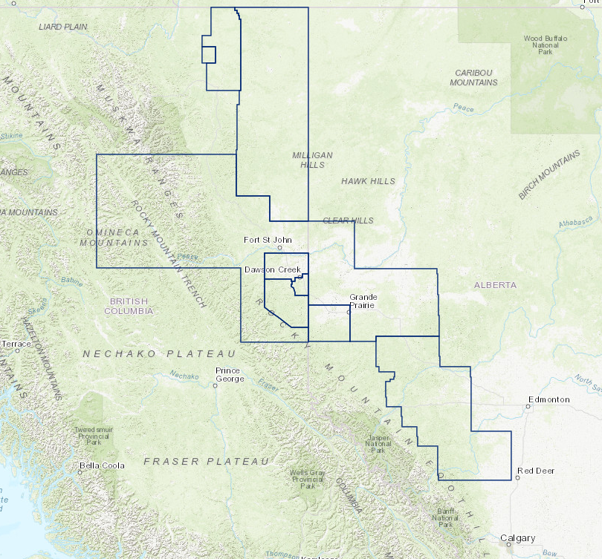
More on the Data
PROJECT BACKGROUND
Data Composition
H₂S data contains events without SCBA (self-contained breathing apparatus) use
Ignore events marked as ‘sensor error’
Testing pool is in Montney
Events
Each event occurs randomly and independently
Events grouped to the nearest site using a distance formula (Haversine)
Duration varies from event to event
Montney
Notes:
The analysis is grounded in several assumptions to ensure data integrity and analytical accuracy.
The H₂S data only includes events where SCBA was not used because when SCBA is used, H2S risks are mitigated because of the control of the breathing atmosphere.
The explosive hazards with LEL are not reduced even if SCBA had been used.
Events that happened due to ‘sensor error’ were also excluded.
Additionally, the testing pool is localized to Montney, which is used to evaluate effectiveness of task labeling prior to a larger roll out.
Regarding the distribution of events, events were assumed to be independent with each event occurring randomly without influence from other events.
Most events were a few hundred meters off from their respective sites and grouped to the nearest site using the Haversine distance.
Additionally…the duration of each event varies, with some occurring within a 1-5 mins window while others occur between 10-15 mins

Slide 9
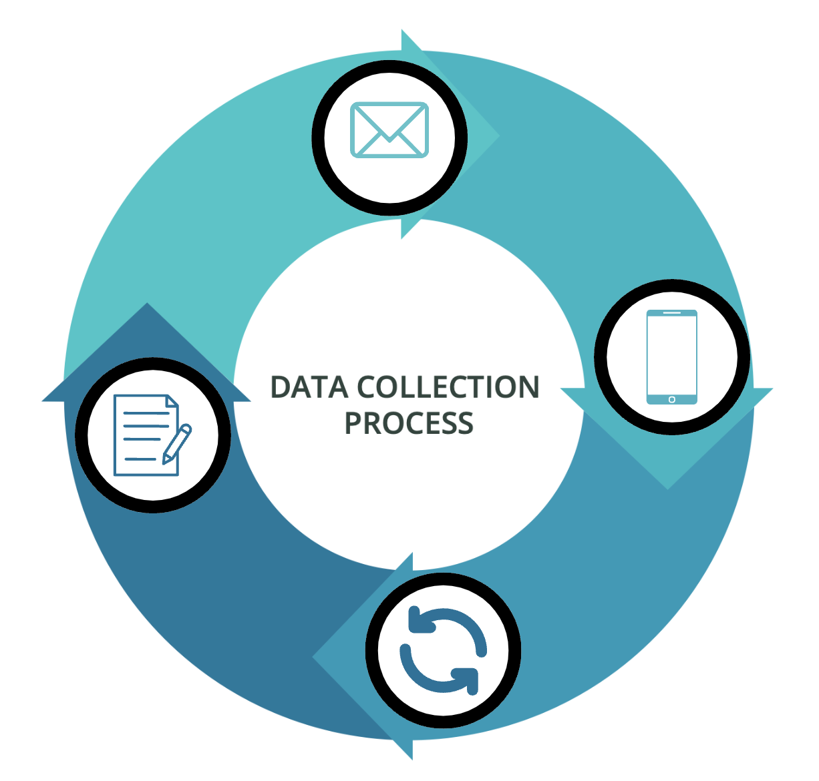
Data Collection Process
PROJECT BACKGROUND
1. Detection & Logging
Monitors detect high H₂S/LEL levels and log entries in the MSSQL database
Limitation: No info on which task the operator performed
2. Email Alert Management
Power Automate handles email alerts
Alerts are sent to ops EOD
3. Power App Interaction
Prompt ops to open the Power App and provide task info
4. Updating Task Information
Task info is updated using the description ops give
Sources: Power Automate, Power App, and MS SQL Server
Notes:
Power Automate: My team and I have developed a process flow using Power Automate to automate the data collection process.
Power Automate acts as the middleman between our team and the field operators, and manages the generation and distribution of email alerts to operators based on H₂S/LEL exposure
The process involves several key steps: 1. An alert is triggered, 2. The alert is recorded as an event in the database, 3. A SQL query retrieves a list of operators associated with these events, 4. These operators receive an email reminder to complete a brief questionnaire on the Power App. The data collected through this process allowed me to identify tasks with higher readings and pinpoint locations with elevated readings compared to the average to reduce the risk.

Slide 10
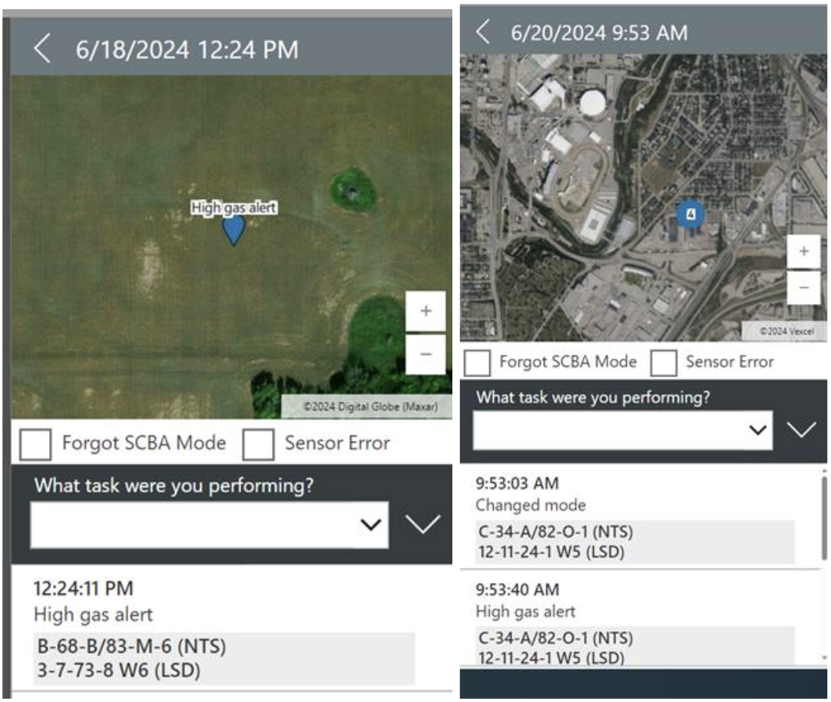
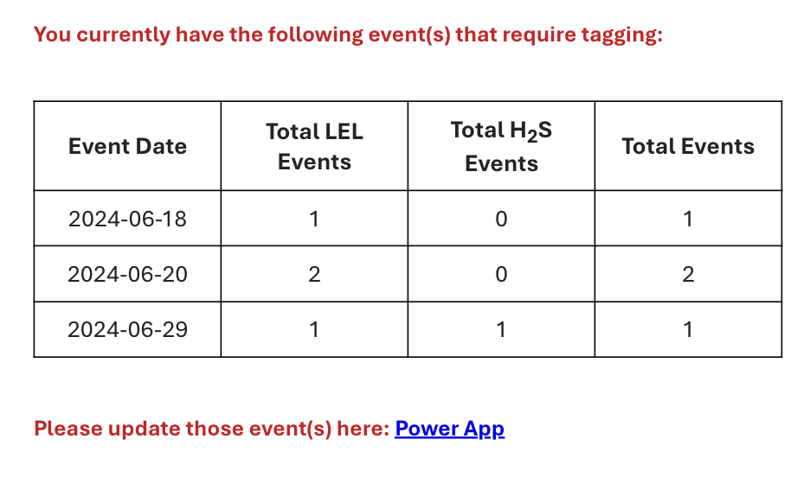
Email Format and Power App
PROJECT BACKGROUND
Sources: Power Automate, Power App, and MS SQL Server
Notes:
Optional
The previous email body did not differentiate the timing of events; all events that had not been labeled were compiled into one number. This can get confusing because if an operator receives such an email, it would be difficult to discern which specific events the number corresponds to, making it challenging to accurately track and address each incident. Some operators have expressed this issue to us in the past. After receiving much needed feedback from one of the field operators we’ve spoken to, Ben McDonald, I was able to make changes to the email body in our Power Automate process.

Slide 11
Profiling Tasks
Profiling Tasks using Task Labeled Data

Slide 12
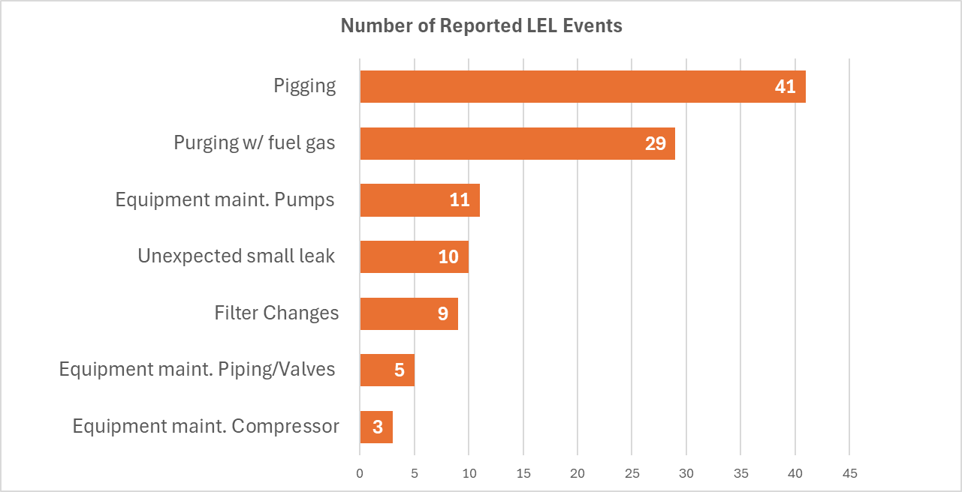
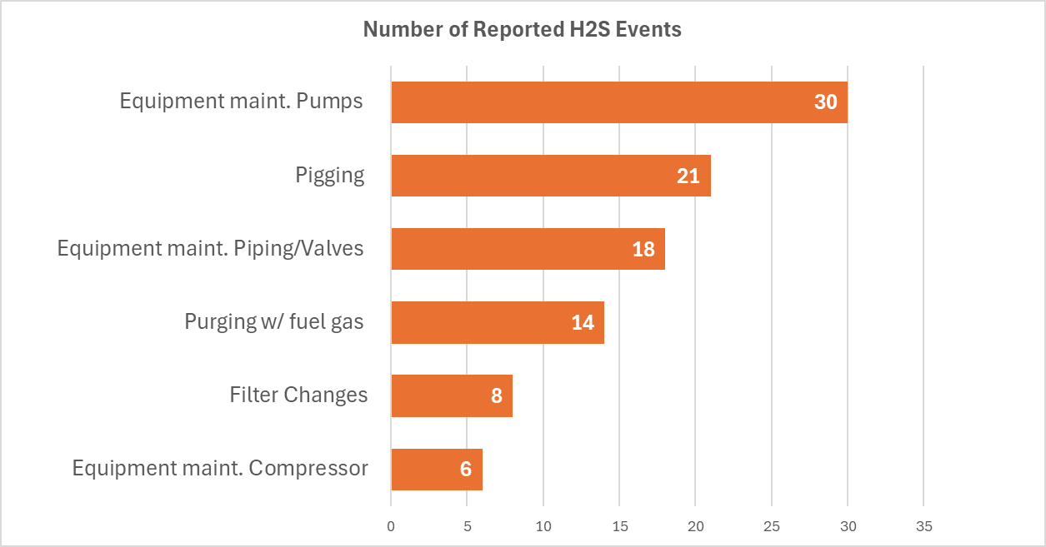
Task Profiles
Profiling tasks
Number of Reported LEL Events
Purging and pigging have the highest number of reported events
More likely to trigger LEL events that have higher LEL percentages on average
Number of Reported H₂S Events
Pumps maintenance and pigging have the highest number of events
More likely to trigger H₂S events that have higher H₂S ppm on average
.
Created Using
Pandas and Matplotlib in Python
Notes:
Using the task labeled data, I was able to profile each of the data.
Number of Reported Events per Task (LEL)
Based on the data presented, it is evident that purging and pigging activities account for the highest number of reported LEL events.
In contrast, maintenance tasks involving compressors, piping, and valves show fewer events.
This indicates that tasks that involve the usage of high pressurized gas such as purging and pigging operations may be more likely to trigger an event that has a higher LEL % than the average for all tasks
Number of Reported Events per Task (H2S)
The data indicates that maintenance activities on pumps and pigging operations report the highest number of H₂S events.
Conversely, maintenance or inspections involving compressors and filter changes exhibit fewer H₂S events. Along with pigging, which converts sour gas to sweet gas, pumps also often handle fluids that contain sour gas (H₂S).
Maintenance activities can release built-up H₂S from the pump components, which explains why these two tasks are more likely to trigger an H2S event when compared to other tasks.

Slide 13
Hot Spot Analysis
Permutation Testing for Getis-Ord Gi* using Locational Data

Slide 14
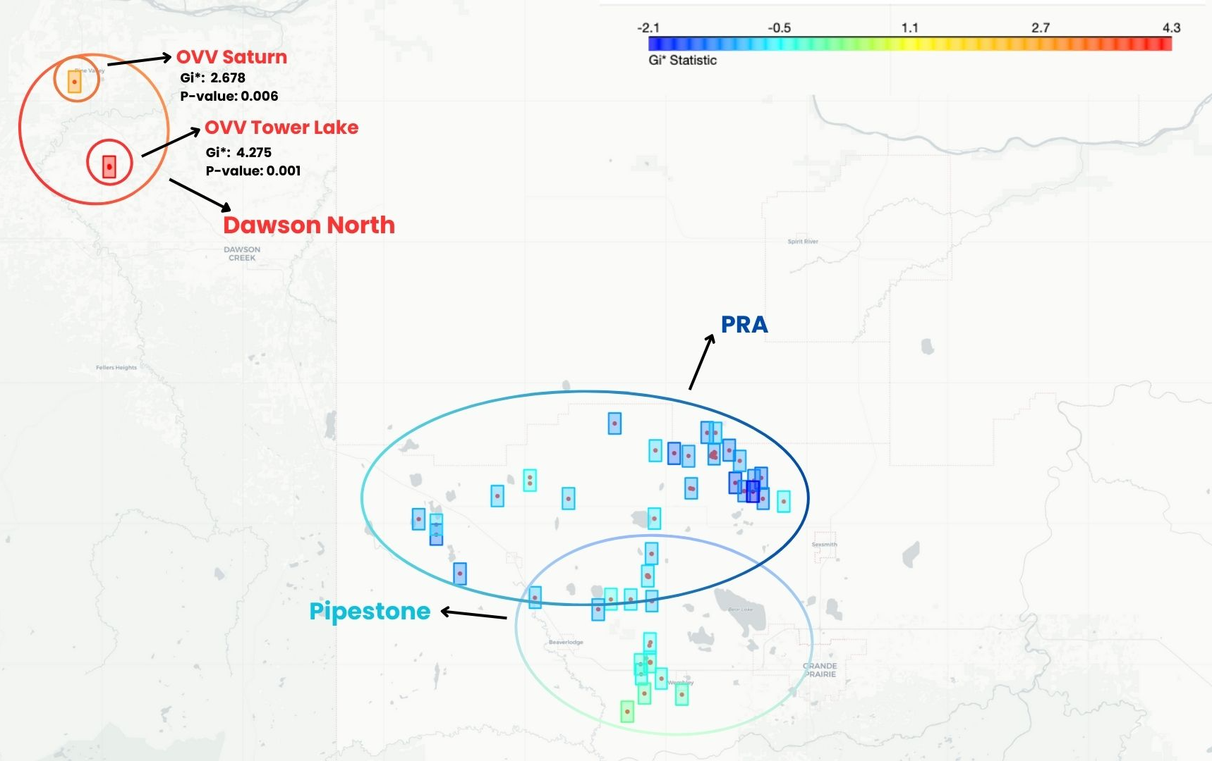
Hot-Spot Analysis: LEL Data
Hot-spot analysis: Permutation testing FOR GETIS-ORD GI*
Hot-Spots Analysis
Two hot-spots in Dawson North
Average LEL's are higher than average for all locations (17.2%)
Mostly purging/pigging events
Tower Lake has two ‘filter changes’ events
These events are above the average LEL for similar events
Tower Lake
Average for all events at Tower Lake: 67.9%
119.1% above the overall average,, close to the LEL threshold
Saturn
Average for all events at Saturn: 49.0%
96.0% higher than the overall average
Modeled Using ESDA, PySal, Folium, NumPy and Statsmodels in Python
Notes:
Information
Using permutation testing for Getis Ord Gi*, two significant hot-spots were identified in Dawson North, which mean these locations had higher average LEL percentages than the average for all locations combined.
Most of the events at these two locations are associated with purging or pigging activities, with two notable instances involving filter changes at Tower Lake, showing LEL percentages 74% and 89% (50 and 59) above the average (23.20) for all events that involved filter changes.
Even though OVV Saturn’s average is higher than the global average, it remains slightly under halfway of the LEL threshold.
However, OVV Tower Lake’s average is right within the range of what is considered flammable, which could pose potential risks for explosive hazards that may need closer monitoring
Optional info on G-Statistics
Gi statistic: Gi* compares local value of an individual location to the global average – Identifies if local pattern of a variable at a location is different to what is generally observed across the whole study area (the average),
Gi* of 0.0: Values of 0.0 suggest no clustering of low or high values
High Gi∗: Indicates a hot spot, meaning high values near location i are clustered (red spots)
Low Gi∗: Indicates a cold spot, meaning low values are clustered near location i. (blue spots)
Outliers are inferred where there is a significant local deviation (p-value < alpha) – for both red and blue spots
Null Hypothesis (H0)
The null hypothesis for the Getis-Ord Gi* test states that: "There is no spatial clustering of high or low values. The observed pattern of values is the result of random spatial processes.”
In other words, under the null hypothesis, the spatial distribution of the variable of interest is random, and any observed clustering of high or low values is due to chance rather than any underlying spatial process.
Alternative Hypothesis (H1)
The alternative hypothesis for the Getis-Ord Gi* test is: There is spatial clustering of high or low values. The observed pattern of values is significantly different from what would be expected under random spatial processes.”
This means that the observed clustering is unlikely to be due to random chance and instead indicates a significant spatial process at work
Optional information on Permutation Testing
Non-parametric
It is an exact statistical non-parametric method used to assess the significance of a test statistic.
It involves constructing an empirical distribution of test statistics through random permutations of the original dataset (number of permutations must be large
Permutation testing doesn't assume normality or a specific distribution, making it suitable for data that may not follow a normal distribution
Null Hypothesis and Testing
The null hypothesis is that all samples come from the same distribution H0 : F = G; under the null hypothesis, the empirical distribution of the test statistic is constructing by calculating all possible values of the test statistic under possible rearrangements of the observed data for a large number of iterations (or permutations)
The observed test statistic is then compared to the empirical distribution to pinpoint its significance (proportion of permutated test statistics that is equal to or exceed the observed test statistic) using a one tailed test (how many actually exceeded as opposed to measuring the extreme ends of both tails).
Empirical Distributions
Number of Iterations that the permutation algorithm was ran: 1,000​
Total sampled permutations: 42,000 for LEL and 43,000 for H2S.
42 test statistics were generated for each iteration for LEL Data (vice versa for H2S).

Slide 15
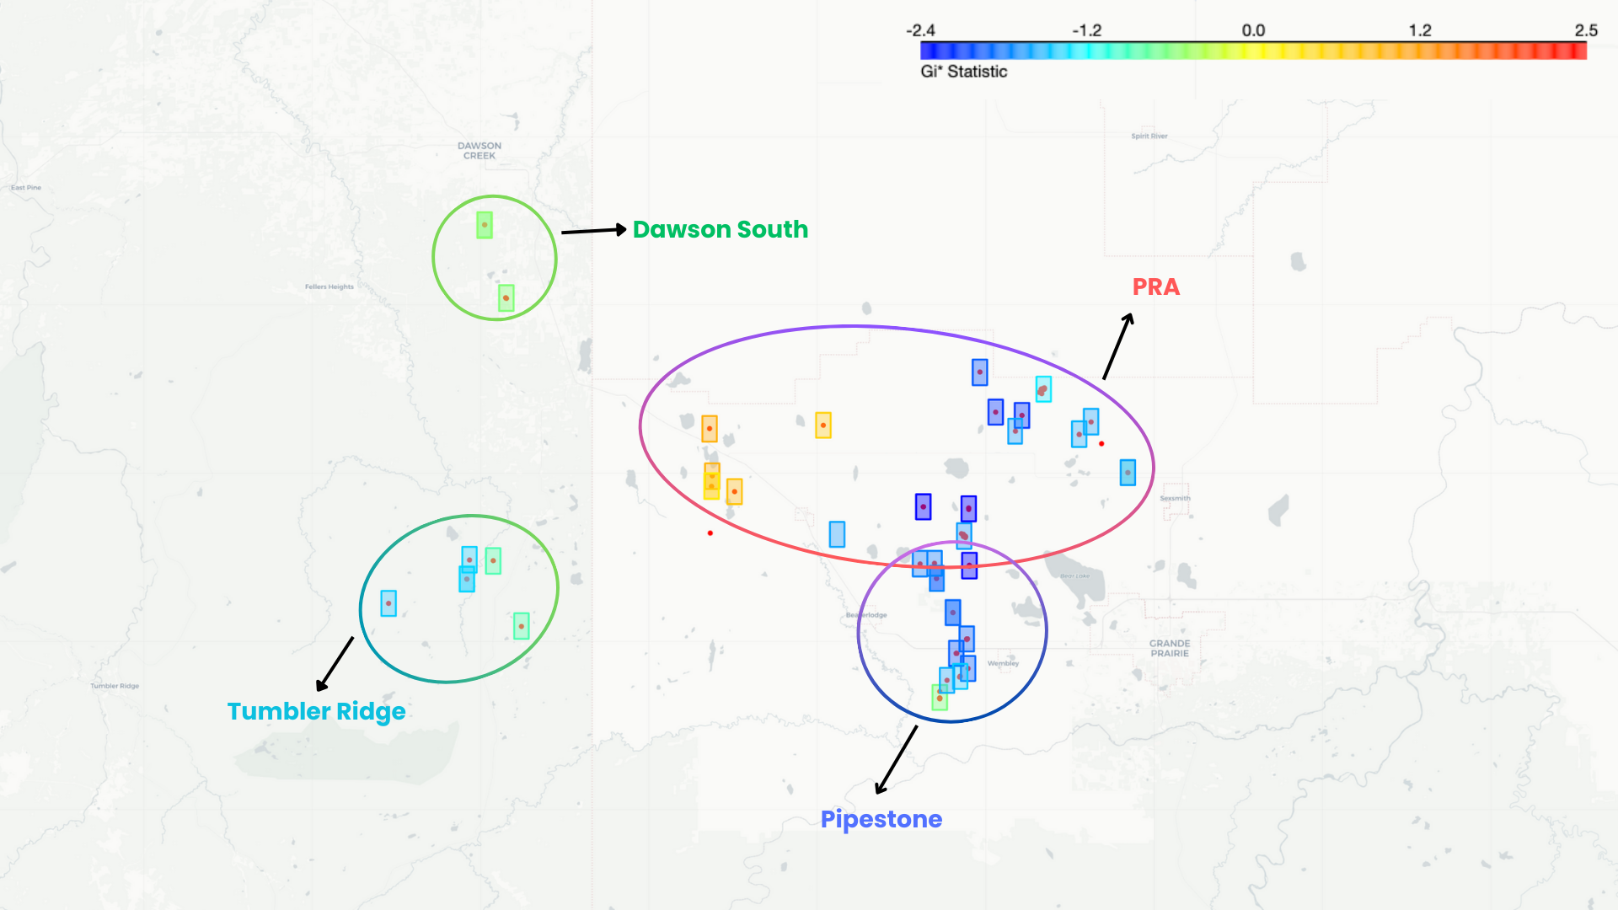
Hot-Spot Analysis: H₂S Data
Hot-spot analysis: Permutation testing FOR GETIS-ORD GI*
Hot-Spots
Compressor stations in west PRA were flagged
Involved pumps/pipes maintenance, or pigging
Profile of West PRA
Average H₂S range 18.4-26.00 ppm
18% to 45% higher than the average H₂S level for all locations combined (16.5 ppm)
Need for closer monitoring
Modeled Using ESDA, PySal, Folium, NumPy and Statsmodels in Python
Notes:
Conclusion
The H2S data highlights that hot-spots in the west PRA are primarily located at individual compressor stations and are associated with maintenance activities such as pumps, piping/valves, and pigging, as expected.
Profile of west PRA indicates that these sites, on average, have higher H₂S levels for events when compared to the rest of the locations in the dataset, showing the need for increased monitoring and enhanced safety measures.

Slide 16
Solutions & Impact

Slide 17
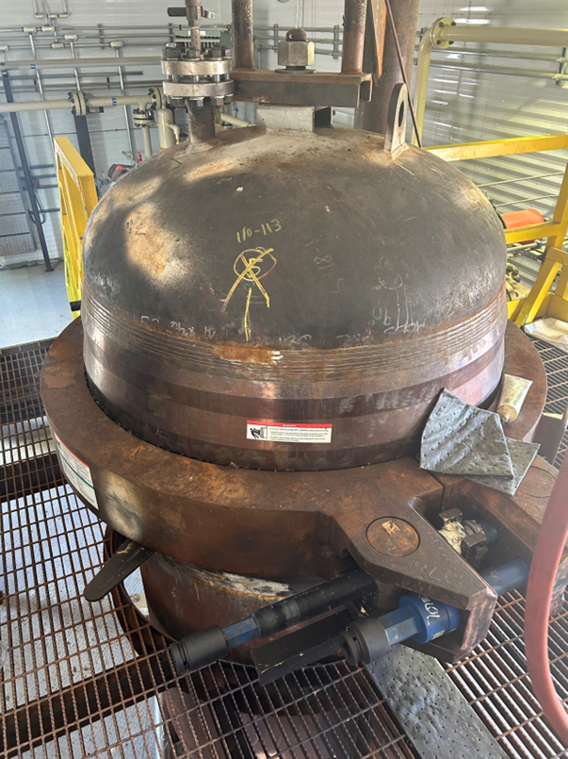

Risk Reduction Solutions
SOLUTIONS & IMPACT
Targeted Approach
Focus on tasks with more practical solutions
Example: Replacing outdated filter pots
Not all processes use these filter pots
Matteo Gagliardi: Ops must delve into the pot to do filter changes, exposing themselves to trapped gases
A widespread issue at Sexsmith.
Potential Improvement
Shawn Simmonds: New filter design allows ops to open the lid in a safer manner (quick-release snap)
An opportunity to reduce number of LEL events at Tower Lake
Beyond the Numbers
Decision-making includes perspectives from ops
Ensure ops are safe and feel safe
Old Filter
Pots
Notes:
Conclusion
Not all tasks require solutions due to the limited risk reduction strategies for certain activities such as pigging and purging. The focus should be on tasks where risk reduction is more achievable, exemplified by the two filter change events at Tower Lake. Filter pots are used to remove impurities and contaminants from fluids during production before it can be treated, disposed of, or recycled.
Through a hot spot analysis, I've identified that the filter change events are concentrated at a few older sites at Tower Lake. These sites are equipped with older filter designs, like what is shown in this picture.
And using the observational data from Matteo Gagliardi, it is revealed that operators must delve into the pot to change filters, exposing them to trapped gases, which explains the spike in LEL %’s. This qualitative data supports the insights obtained via the statistical analysis, highlighting a potential problem at Tower Lake. These filter pots also have been a widespread issue at another location, Sexsmith.
One potential solution is to consider using a new filter design.
I spoke with Shawn Simmonds, a plant coordinator in Dawson North, who pointed out that newer filter models come with a quick-release snap mechanism, which removes the need to manually unscrew each bolt to open the lid. Additionally, the new filters are more compact, enabling operators to change them more easily without reaching deep inside the filter pots.
Filter changes occur on a biweekly or monthly basis, so this potential solution presents an opportunity to improve the efficiency of our maintenance routine and potentially reduce the frequency of LEL events at Tower Lake.
I also want to say that decision-making extends beyond the numbers. Ensuring operator safety involves not only mitigating actual risks but also fostering a sense of security. It's crucial that operators not only are safe but also feel safe.

Slide 18






Project Impact
SOLUTIONS & IMPACT
Employee Safety
Improved working conditions can lead to greater job satisfaction
Company Reputation
Commitment to safety can boost reputation of company
Key stakeholders: employees and investors
Communication
Daily emails have been increasing communications
Fosters a proactive and collaborative safety culture
Notes:
By continuing safety and risk reduction, we can yield many benefits across the organization. Enhanced employee safety fosters improved working conditions, leading to greater job satisfaction and workforce stability. Long-term commitment to sustaining a safe working environment can also boost the company's reputation, aligning with the interests of key stakeholders, including employees and investors.
Effective communication channels, such as daily emails, have enhanced interactions between operators and the Environmental, Health, and Safety (EH&S) team. This increased in communications can help foster a proactive and collaborative safety culture, which ensures that safety protocols are consistently reinforced across the organization.

Slide 19
Next Steps

Slide 20
Next Steps of the Project
NEXT STEPS
Location Granularity
Focus on individual equipment and tools for precise data
Allows thorough inspections and potential upgrades
Advanced Analytics
Regression Algorithms: Predict risk scores for specific tasks
Classification Algorithms: Identify the most probable risk types
Apply sentiment analysis techniques on comments made by ops
Notes:
The foundational work of this project has been laid out by my team and I. Some possible next steps include enhancing location granularity by focusing on individual equipment and tools for thorough inspections, and upgrades. Also, by capturing more data on LEL and H2S readings and task descriptions, we can leverage advanced analytics, including regression algorithms to predict risk scores and classification algorithms to identify probable risk types. Additionally, incorporating comments from operators allows for sentiment analysis, providing deeper insights into risk assessment and management beyond using numbers.
using techniques like word embedding models

Slide 21
And all our COA field operators!
Thank You!
Matt Gibson Matteo Gagliardi Bill Marshall Liam Hodgins
Ryan Luedey
Logan Noonan
Sam DiBaggio
Tony Tran
Courtney Morrison
Abigayle Fisch
Ben MacDonald
Jordan Wenzel

